Slide 1
SCIENTIFIC CALCULATOR A GUI PROJECT
Submitted by : Deepshikha Dey(11902067) B-38
Ankesh Tripathi (11902344) A-16
Ajaypal Singh (11909260) B-68

Slide 2
CONTENTS:-
OBJECTIVE
DESCRIPTION OF THE PROJECT
WORK DIVISION
ABOUT THE PROJECT
CONCLUSION AND RESULTS
BIBLIOGRAPHY

Slide 3
Objectives :-
To Create a GUI of Scientific Calculator and understand its working.
To understand the working of various modules which are being used to create this interface.
To create a user friendly interface which can be accessed by everyone easily.

Slide 4
DESCRIPTION OF THE PROJECT :-
The project includes the following:
Simple calculator Interface
Choice between standard and scientific calculator in file menu
Made by sub menu
An Exit Button in file menu

Slide 5
Work division of members:-
DEEPSHIKHA DEY
ANKESH TRIPATHI
AJAYPAL SINGH

Slide 6
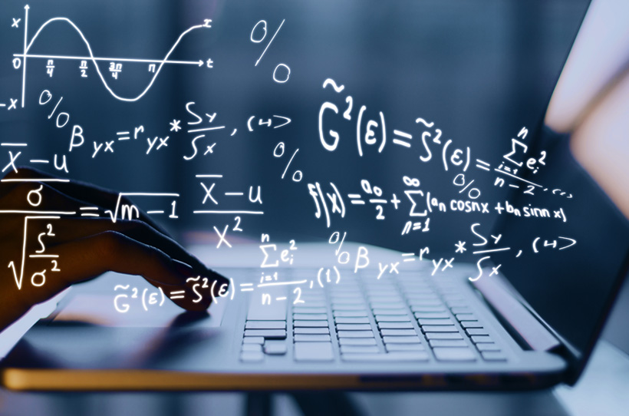

Scientific CALCULATOR :-
Let’s forward to next slides to get further information about our project……

Slide 7
ABOUT THE PROJECT:-
Coded in python and comes with a graphical user interface to facilitate the users.
Use of Tkinter in Python for making GUI . Python when combined with Tkinter provides a fast and easy way to create GUI applications

Slide 8
Let’s get a look towards the Project through some of the snapshots of it…

Slide 9
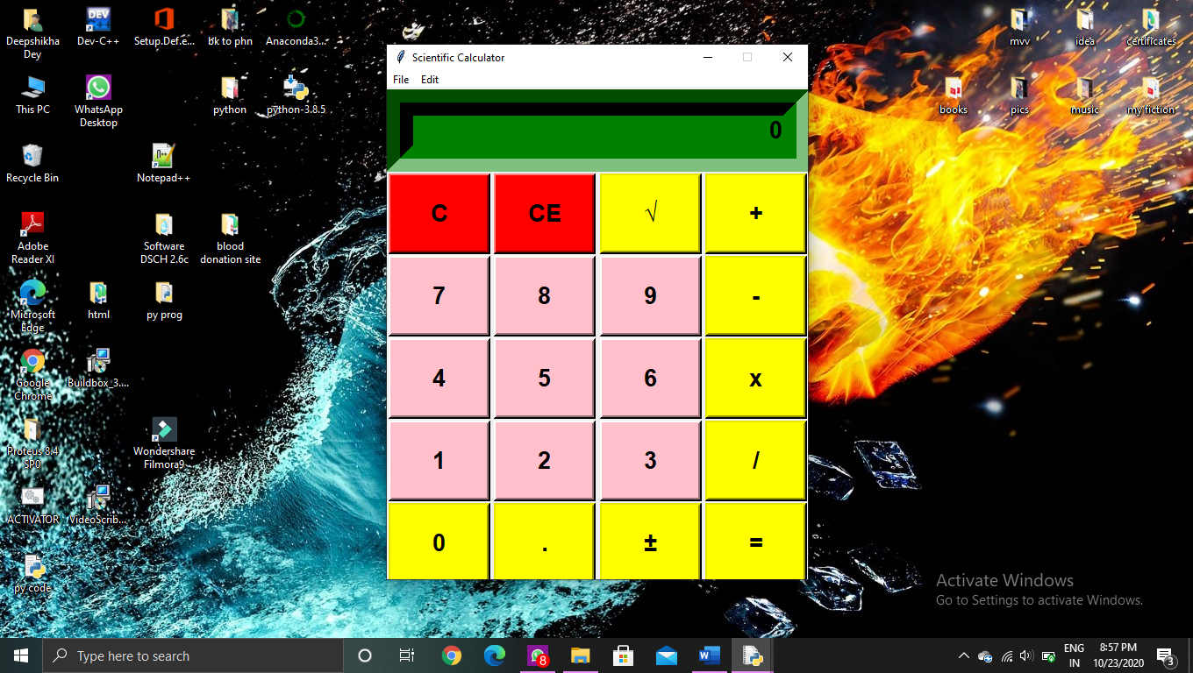
STANDARD CALCULATOR INTERFACE:-
GENERAL PURPOSE CALCULATOR

Slide 10
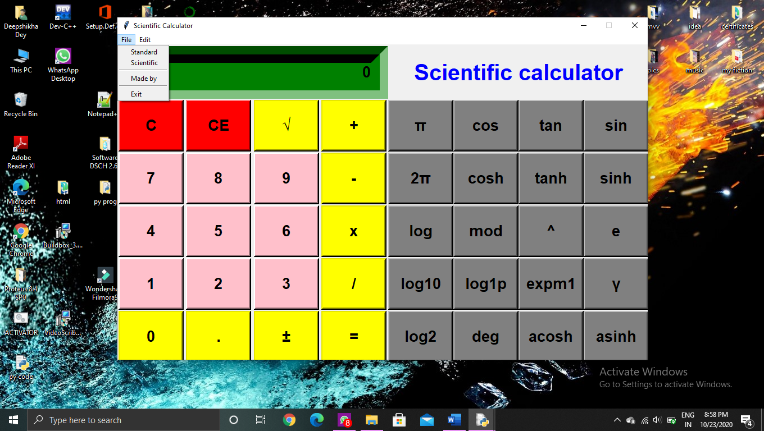
SCIENTIFIC CALCULATOR

Slide 11
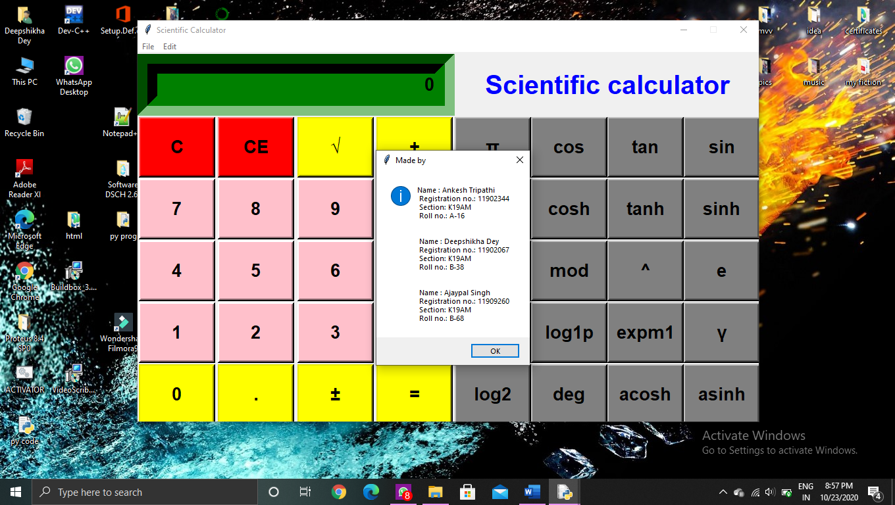
MEMBERS NAME INDULGED IN MAKING OF THIS PROJECT:

Slide 12
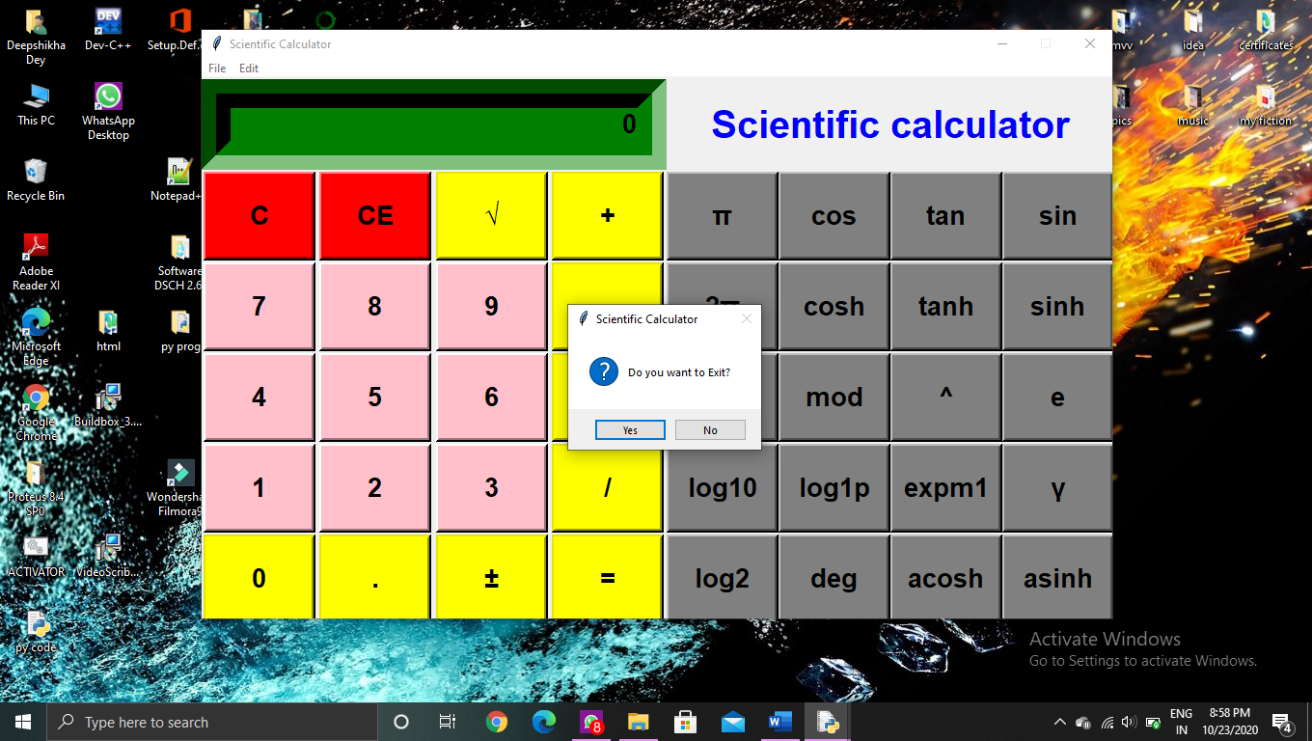
EXIT BUTTON INTERFACE:-

Slide 13
CONCLUSION AND RESULTS
The end product is obtained that includes all the mentioned modules discussed earlier.
Learnt to make a GUI using Tkinter in Python.
Learnt to implement database connectivity using sqlite3.
The Project is capable of calculating the problems in science, engineering and mathematics
Scientific calculators have eliminate tedious computations and algebraic manipulations. When they are used appropriately, calculators enhance learning and thinking. They are time saving.

Slide 14
BIBLIOGRAPHY
https://www.w3schools.com/python/
https://docs.python.org/3/library/functions.html
https://www.python-course.eu/index.php
https://www.geeksforgeeks.org/sql-using-python/
https://python-forum.io/index.php
https://stackoverflow.com/
www.tutorialspoint.com
www.reddit.com
www.google.co.in

Slide 15
Thankyou

